Slide 1
Intermediate Coding Week 6
Inheritance

Slide 2

Classes Review

Slide 3

Minecraft Steve
If we were making a class for Minecraft Steve, what would be his:
State?
Behavior?

Slide 4

Minecraft Zombie
If we were making a class for a Minecraft zombie, what would be their:
State?
Behavior?

Slide 5

Inheritance

Slide 6
Is-a relationships, hierarchies
Polygon
Pentagon
Quadrilateral
Triangle
Parallelogram
Rhombus
Rectangle
Square
is-a relationship: A hierarchical connection where one category can be treated as a specialized version of another.
every rectangle is a polygon
every square is a rectangle
inheritance hierarchy: A set of classes connected by is-a relationships that can share common code.

Slide 7

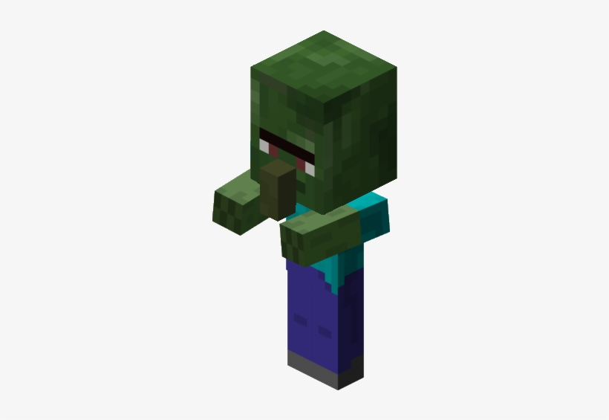

A Minecraft example with Zombies!
Zombie
Baby Zombie
Zombie Villager
Baby Zombie Villager
All zombies say “brains” and burn in sunlight.
Zombies are 2 blocks tall.
Baby zombies are 1 block tall.
Baby zombies can ride chickens.
Zombie villagers can be cured with golden apples, in which case they turn back into a villager.

Slide 8
Inheritance
inheritance: A way to form new classes based on existing classes, taking on their attributes/behavior.
a way to group related classes
a way to share code between two or more classes
One class can extend another, absorbing its data/behavior.
superclass: The parent class that is being extended.
subclass: The child class that extends the superclass and inherits its behavior.
Subclass gets a copy of every field and method from superclass

Slide 9
Inheritance syntax
public class name extends superclass {
Example:
public class Triangle extends Polygon {
...
}
By extending Polygon, each Triangle object now:
receives a points field and a getPerimeter method automatically
can be treated as a Polygon by client code (seen later)

Slide 10
New methods/fields
public class Triangle extends Polygon {
boolean isEquilateral;
...
public Point getCentroid() {
...
}
...
}
Along with receiving the fields and methods of its superclass, a subclass can create new fields and methods.
The superclass does not inherit these new fields and methods.

Slide 11
Inheritance and Constructors

Slide 12
Inheritance and constructors
Imagine that we want to give the Zombie class some more information by adding a new field to represent their position.
Zombie villagers will also have an additional field for their job (which they used to have before they were turned into a zombie).
This means we might want to create a constructor for the Zombie class where we pass in the position.
We also might want to create a constructor for the Zombie villager class involving their job as well as their position.

Slide 13
Problem with constructors
Now that we've added the constructor to the Zombie class, our subclasses do not compile. The error:
Zombie.java:2: cannot find symbol
symbol : constructor Zombie()
location: class Zombie
public class BabyZombie extends Zombie {
^
The short explanation: Once we write a constructor (that requires parameters) in the superclass, we must now write constructors for our subclasses as well.
The long explanation: (next slide)

Slide 14
The detailed explanation
Constructors are not inherited.
Subclasses don't inherit the Zombie(int) constructor.
Subclasses receive a default constructor that contains:
public BabyZombie() {
super(); // calls Zombie() constructor
}
But our Zombie(int) replaces the default Zombie().
The subclasses' default constructors are now trying to call a non-existent default Zombie constructor.

Slide 15
Calling superclass constructor
super(parameters);
Example:
public class BabyZombie extends Zombie {
public BabyZombie(int x) {
super(x); // calls Zombie constructor
}
...
}
The super call must be the first statement in the constructor.

